Slide 1

UNIT – III SEARCH TREES

Slide 2
Contents
AVL Trees Definition
Height of an AVL Tree
Operations – Insertion
Deletion and Searching,
Splay Trees

Slide 3
AVL TREE
An AVL tree is a search tree in which the heights of the sub trees differ by no more than 1. It is thus a balanced binary tree.
An AVL tree is a binary tree that either is empty or consists of two AVL sub tree, T_{L} and T_{R}, whose heights differ by no more than 1.
| H_{L} - H_{R} | < = 1
Where H_{L} is the height of the left sub tree, H_{R} is the height of the right sub tree.The bar symbols indicate absolute value.

Slide 4
The AVL Tree Data Structure
Adelson-Velskii and Landis
An AVL tree is:
A binary search tree
Heights of left and right subtrees of every node differ by at most 1
8
5
11
2
6
10
12
4
7 9
13 14
15

Slide 5
Recursive Height Calculation
Recall: height is max number of edges from root to a leaf
A
^{h}leftt
^{h}right
How do we compute height at A?
Note: height(null) = -1

Slide 6
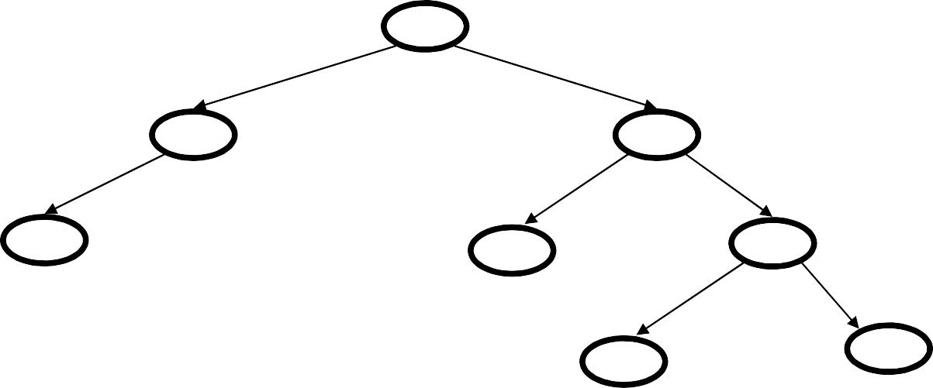
AVL Tree?
6
3
4
1
8
2
1
0
0
7
11
1
0
10
12
0

Slide 7
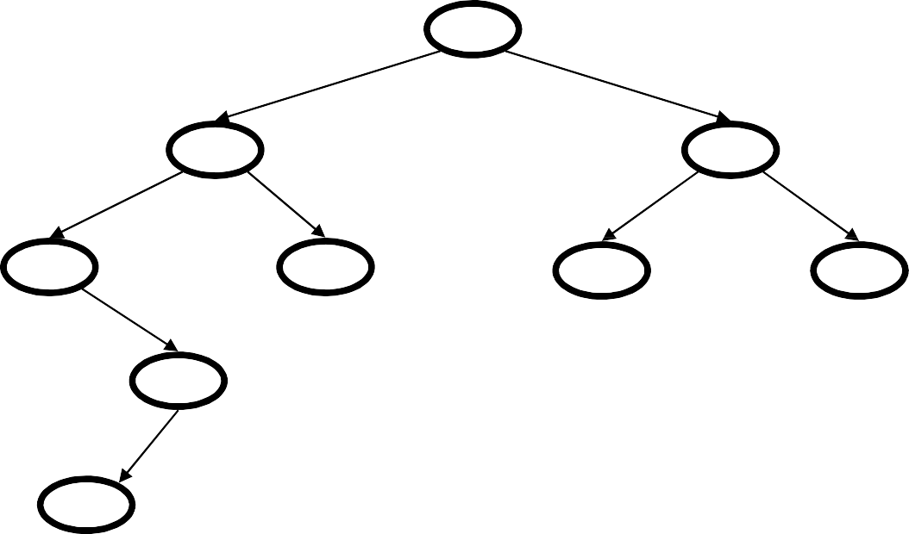
AVL Tree?
4
6
3
4
8
1
2
1
5
0
0 7
11
0
3
1
0
2

Slide 8
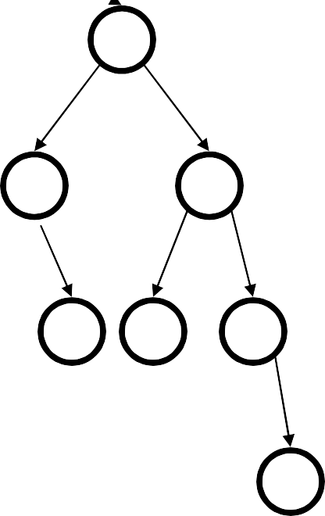
An AVL Tree has Height O(log n)
Proof Let S(h) be the min # of nodes in an AVL tree of height h
AVL tree of height h=4
with the min # of nodes (12)
Claim: S(h) = S(h-1) + S(h-2) + 1
8
4
Solution of recurrence:
S(h) = O(2^{h})
(like Fibonacci numbers)
5
2
11
3
2
0
6
1
10
1
12
2
7
0
9 13 14 1
0 0
15
0

Slide 9
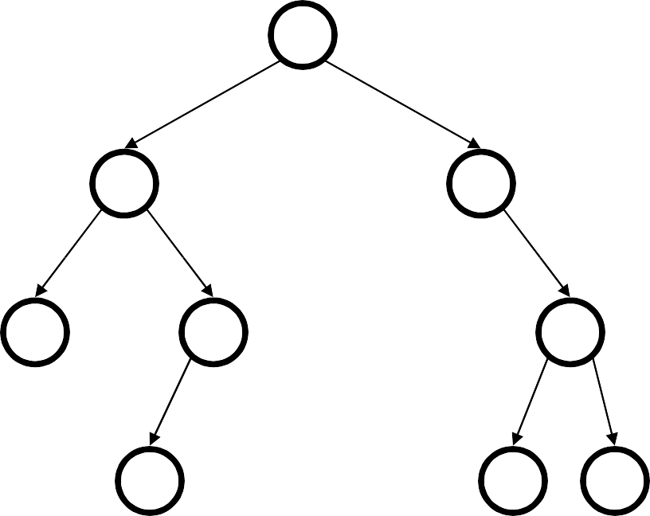
Testing the Balance Property
10
We need to be able to:
1. Track Balance
5
15
2. Detect Imbalance
2
9
20
3. Restore Balance
7
17 30
NULL has a height of -1

Slide 10

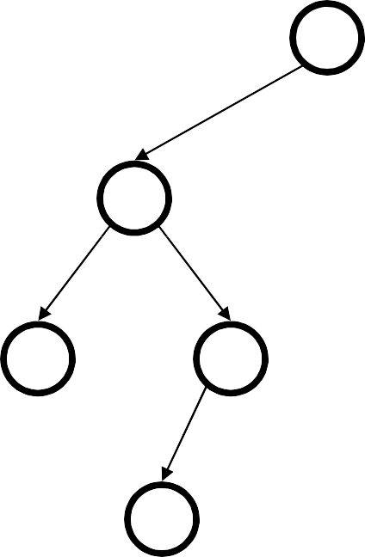
An AVL Tree
10
3
data height children
3
10
2
2
5
20
0
1
1
15
0
30
2
9
0
0
17
7
Track height at all times.

Slide 11
AVL trees: find, insert, delete
AVL find:
Same as BST find.
AVL insert:
Same as BST insert, except you need to check your balance and may need to “fix” the AVL tree after the insert.
AVL delete:
We’re not going to talk about it, but same basic idea. Delete it, check your balance, and fix it.

Slide 12
Bad Case #1
Insert(6) Insert(3) Insert(1)
6
3
1
Simple illustration

Slide 13
Fix: Apply Single Rotation
AVL Property violated at this node (x)
2 1
6
3
1
3
0
0
1
6
1
0
Intuition: 3 must become root
Single Rotation:
1. Rotate between x and child
Simple illustration

Slide 14
Bad Case #2
Insert(1) Insert(6) Insert(3)
1
6
3

Slide 15
Single Rotation Does Not Work
AVL Property violated at this node (x)
It’s a BST, but it’s unbalanced
2
2
1
1
1
6
1
3
0
6
0
3

Slide 16
Fix: Apply Double Rotation
AVL Property violated at this node (x)
2
2
1
1
1
3
1
1
6
3
0
0
0
1
6
0
3
6
Double Rotation
1. Rotate between x’s child and grandchild
2. Rotate between x and x’s new child

Slide 17
AVL tree insert
Find spot for new key
Hang new node there with this key
Search back up the path for imbalance
If there is an imbalance:
Case #1: Perform single rotation and exit
Case #2: Perform double rotation and exit
Both rotations keep the subtree height unchanged.
Hence only one rotation is sufficient!

Slide 18
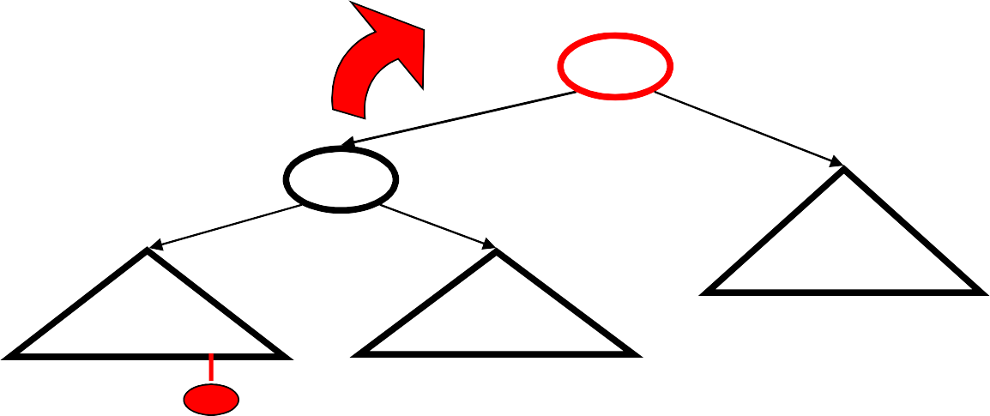
Case #1: Single Rotation
a
h+3
h+2
h
b
h+1
h
Z
X
Y
single rotation
X < b < Y < a < Z
b
a
X
Y
Z

Slide 19
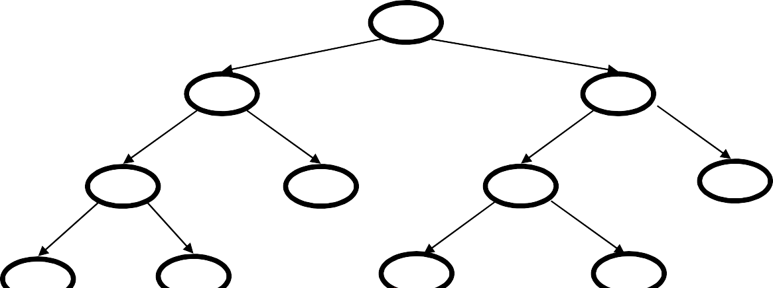
Single rotation example
15
8 22
4
10 19
24
3
6
17
20
16

Slide 20
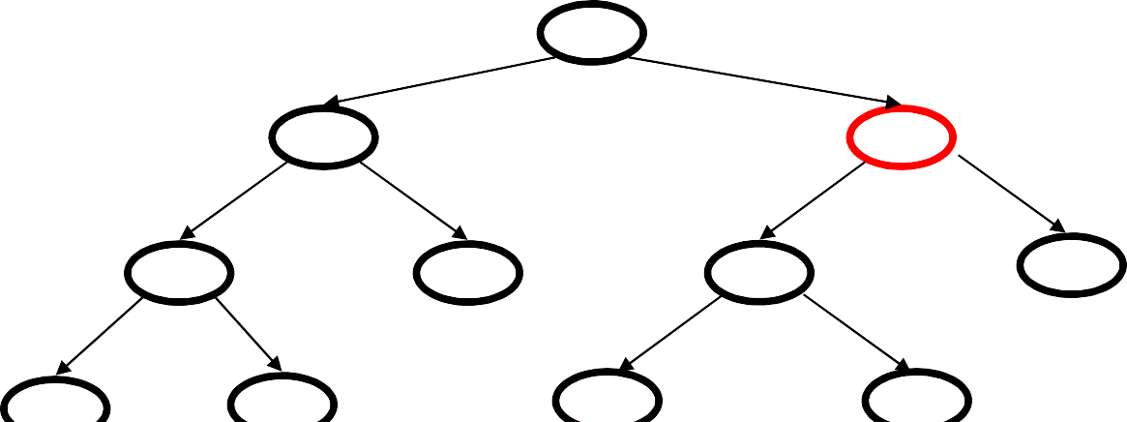
Single rotation example
15
8 22
4
10 19
24
3
6
17
20
16

Slide 21
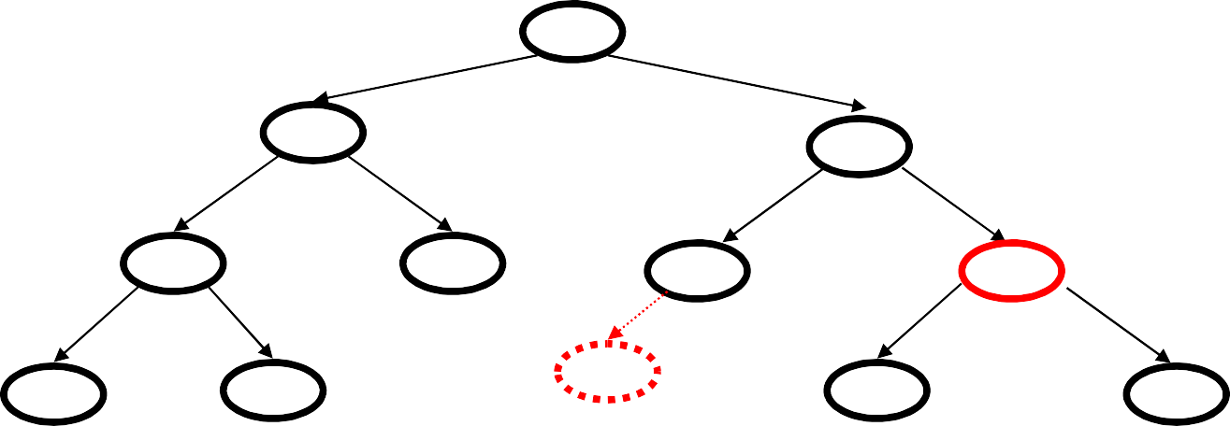
Single rotation example
15
8 22
4
10 19
24
3
6
17
20
16
15
8
19
4
10
17
22
3
6
16
20
24

Slide 22
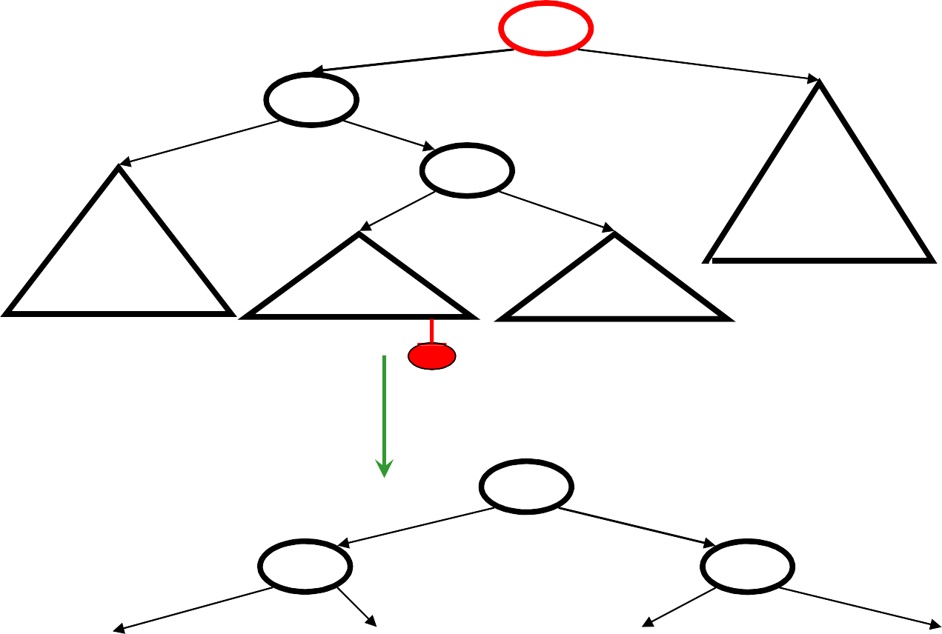
Case #2: Double Rotation
a
h+3
h+2
b
h
h
h+1
c
h
U
h-1
Z
X
V
Insert on left child’s right (at U or V)
Let’s break subtree into pieces:
c

Slide 23
Case #2: Double Rotation
a
h+3
h+2
b
h
h
h+1
c
h
U
h-1
Z
X
V
Insert on left child’s right (at U or V)
Let’s break subtree into pieces:
c
b

Slide 24
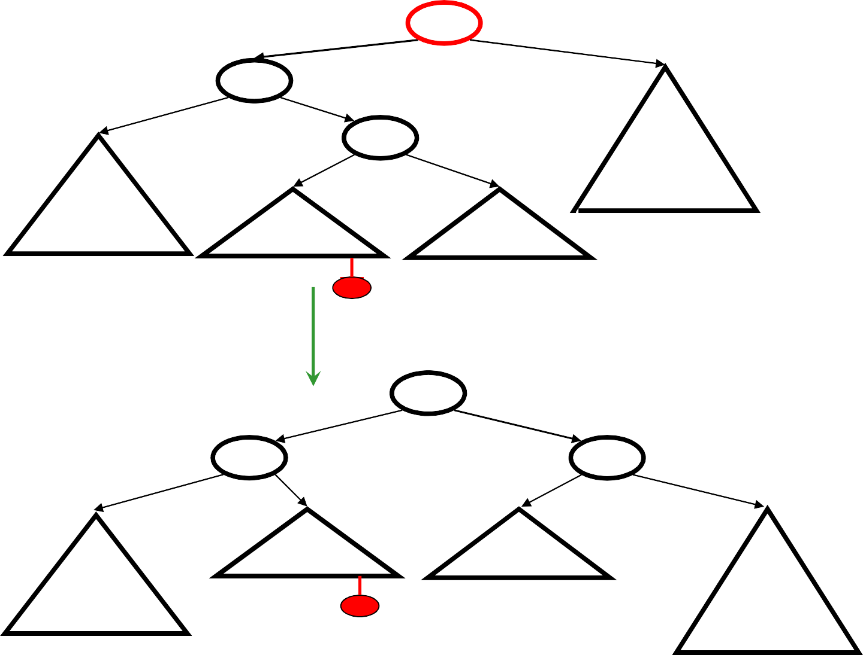
Case #2: Double Rotation
a
h+3
h+2
b
h
h
h+1
c
h
U
h-1
Z
X
V
Insert on left child’s right (at U or V) c
a
Let’s break subtree into pieces:
b
U
V
X
Z

Slide 25
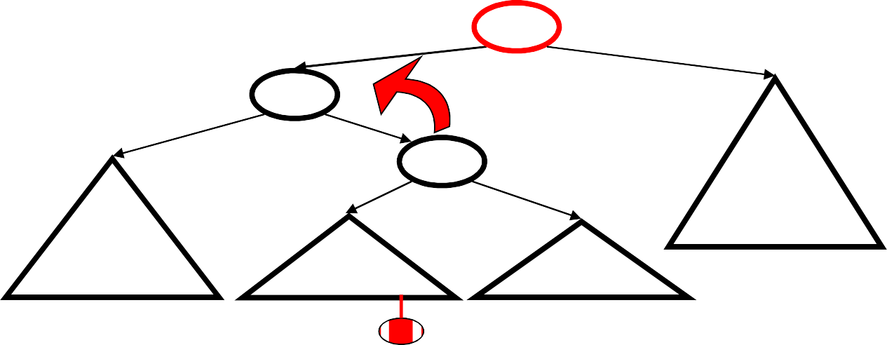
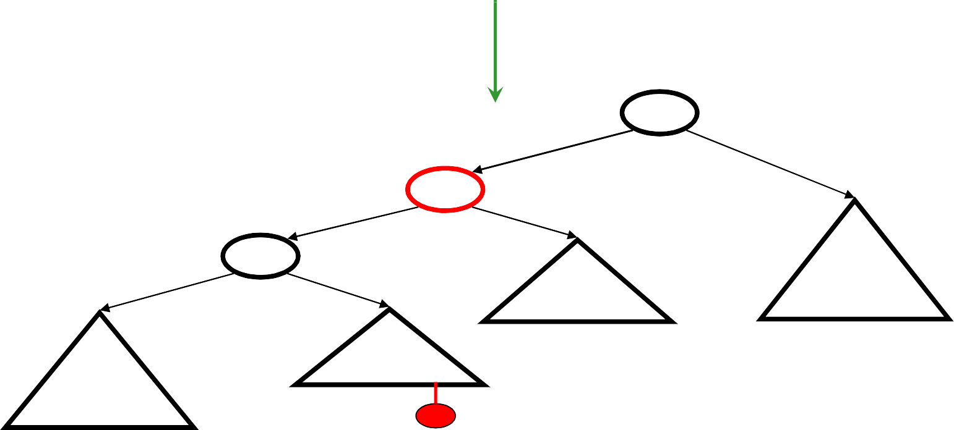
Can also do this in two rotations
a
h+3
h+2
h
b
h
h+1
c
h
U
h-1
Z
X
V
First rotation
X < b < U < c < V < a < Z
a
c
h
h-1
b
h
h
V
Z

Slide 26
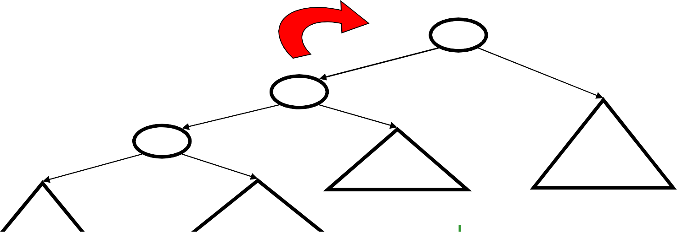
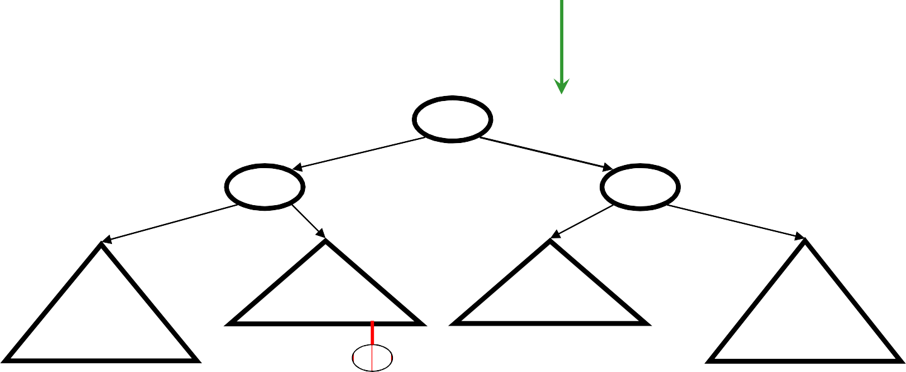
Second rotation
a
h+3
h+2
c
h
h+1
h-1
b
h
h
V
Z
U
X
Second rotation
c
h+1
b
a
h
h
h-1
h
U
V
X
Z

Slide 27
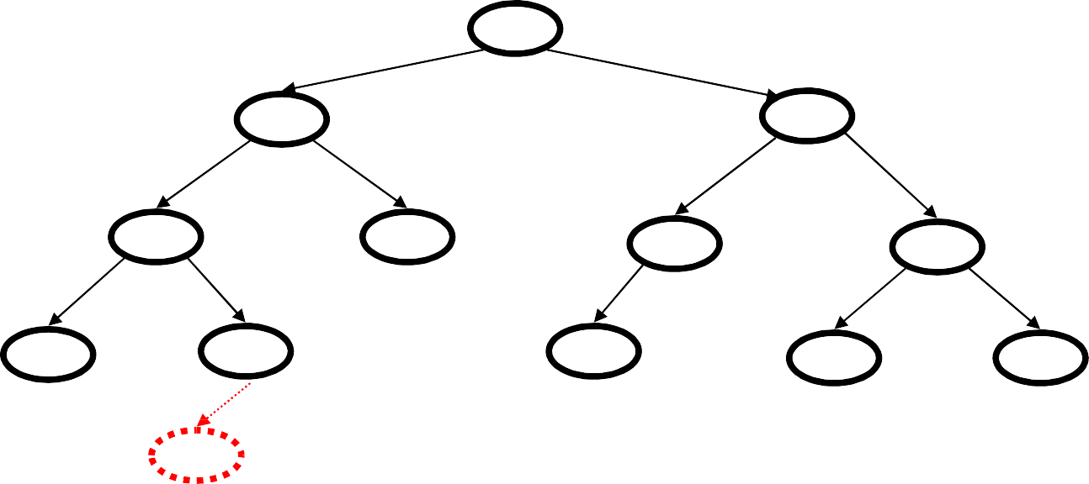
Double rotation example
15
8
19
4
10
17
22
3
6
16
20
24
5

Slide 28
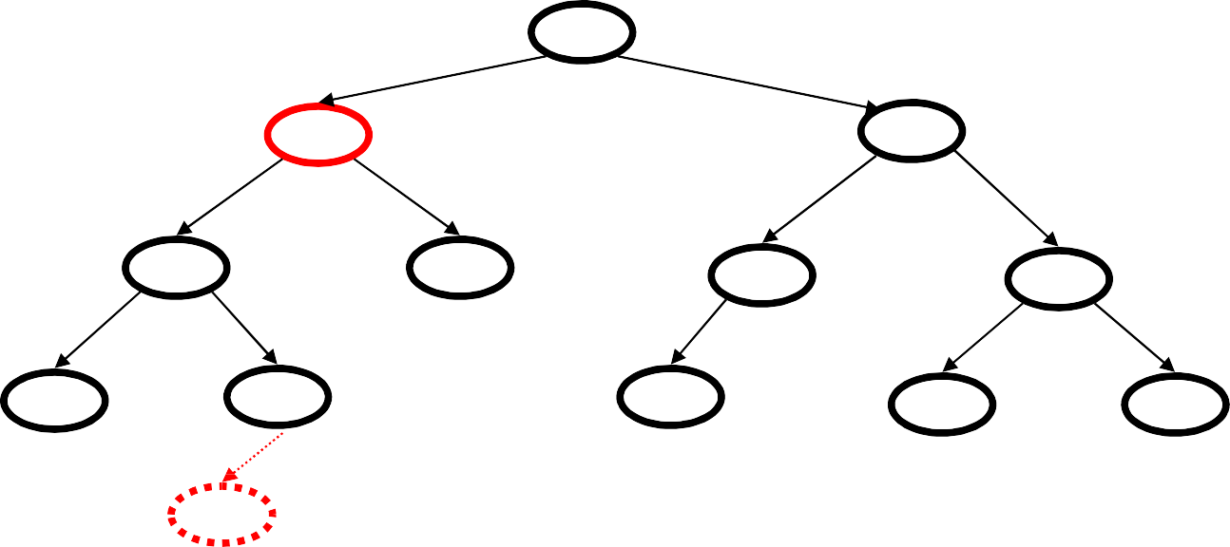
Double rotation example
15
8
19
4
10
17
22
3
6
16
20
24
5

Slide 29
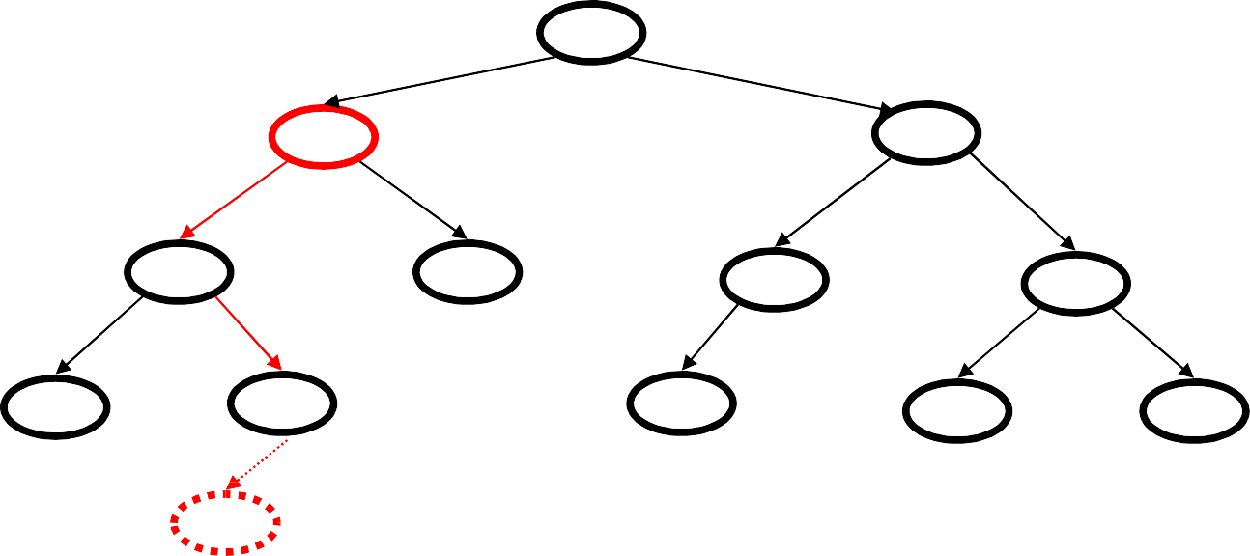
Double rotation example
15
8
19
4
10
17
22
3
6
16
20
24
5

Slide 30
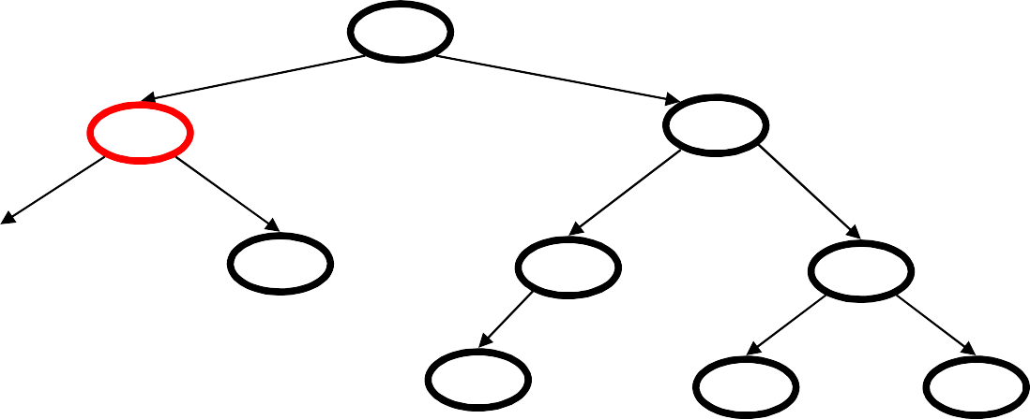
Double rotation example
15
8
19
4
10
17
22
3
6
16
20
24
5
15
8
19
10
17
22
16
20
24

Slide 31
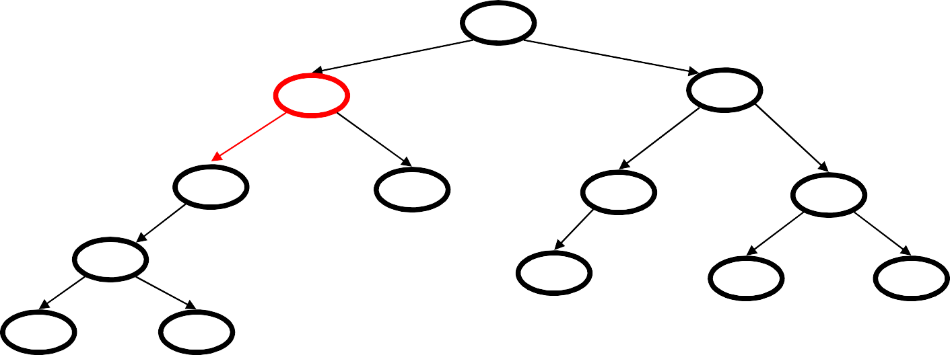
Double rotation example
15
8
19
4
10
17
22
3
6
16
20
24
5
15
8
19
6
10
17
22
4
16
20
24
3
5

Slide 32
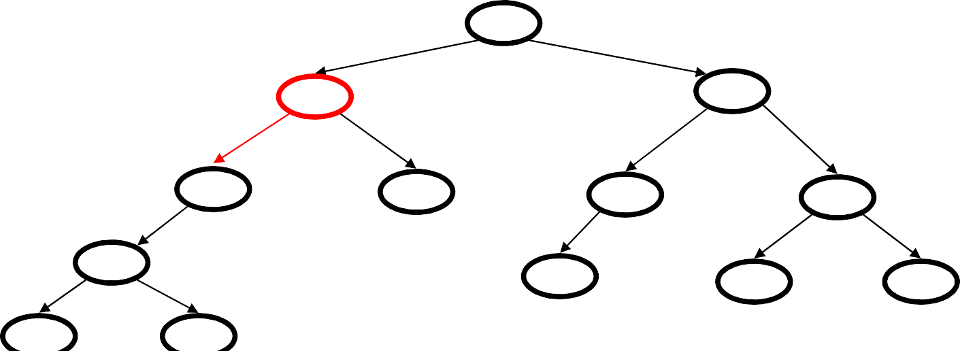
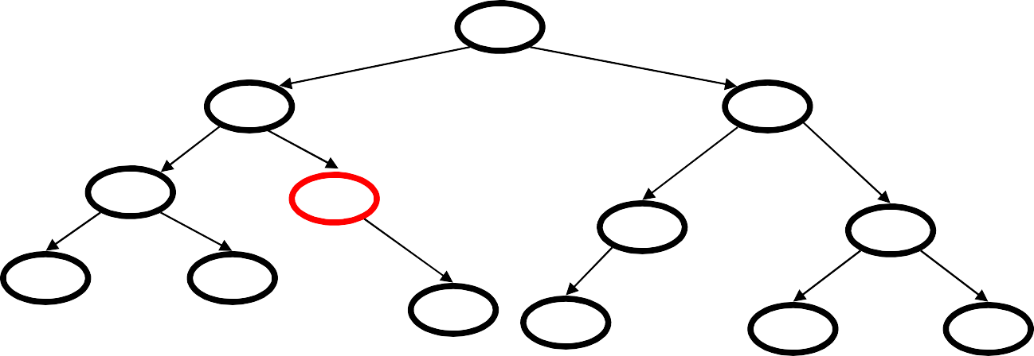
Double rotation example
15
8
19
6
10
17
22
4
16
20
24
3
5
15
6
19
4
8
17
22
3
5
10
16
20
24

Slide 33
Case #3:
h+3
a
h+2
h
h+1
b
c
h
h
h-1
X
Z
U
V
Double rotation
h+2
c
h+1
h+1
a
b
h
h
h-1
h
U
V
X
Z

Slide 34
Case #4:
h+3
a
h+2
h
b
h
h+1
X
Y
Z
Single rotation
h+2
b
h+1
a
h+1
h
h
Z
X
Y

Slide 35
Recap of AVL tree insert
Let x be the node where an imbalance occurs.
Four cases to consider. The insertion is in the
left subtree of the left child of x.
right subtree of the left child of x.
left subtree of the right child of x.
right subtree of the right child of x.
Cases 1 & 4 are solved by a single rotation
Cases 2 & 3 are solved by a double rotation

Slide 36
AVL complexity
What is the worst case complexity of a find?
O(log n)
What is the worst case complexity of an insert?
O(log n)
What is the worst case complexity of build a AVL Tree?
O(n log n)

Slide 37
SPLAY TREES

Slide 38
Splay Trees
Splay trees are binary search trees (BSTs) that:
Are not perfectly balanced all the time
Allow search and insertion operations to try to balance the tree so that future operations may run faster
Based on the heuristic:
If X is accessed once, it is likely to be accessed again.
After node X is accessed, perform “splaying” operations to bring X up to the root of the tree.
Do this in a way that leaves the tree more or less balanced as a whole.

Slide 39
Motivating Example
Root
Root
15
After Search(12)
12
2
6
18
Splay idea: Get 12
up to the root
using rotations
6
15
1
3
12
3
9
14
18
9
14
After splaying with 12
Initial tree
Not only splaying with 12 makes the tree balanced, subsequent accesses for 12 will take O(1) time.
Active (recently accessed) nodes will move towards the root and inactive nodes will slowly move further from the root

Slide 40
Splay Tree Terminology
Let X be a non-root node, i.e., has at least 1 ancestor.
Let P be its parent node.
Let G be its grandparent node (if it exists)
Consider a path from G to X:
Each time we go left, we say that we “zig”
Each time we go right, we say that we “zag”
There are 6 possible cases:
G
G
G
G
P
P
P
P
P
P
X
X
X
X
X
X
1. zig-zig
2. zig-zag
3. zag-zig
4. zag-zag
5. zig
6. zag

Slide 41
Splay Tree Operations
When node X is accessed, apply one of six rotation operations:
Single Rotations (X has a P but no G)
zig, zag
Double Rotations (X has both a P and a G)
zig-zig, zig-zag
zag-zig, zag-zag

Slide 42
Splay Trees: Zig Operation
“Zig” is just a single rotation, as in an AVL tree
Suppose 6 was the node that was accessed (e.g. using Search)
15
6
Zig-Right
6
18
15
3
3
12
12
18
“Zig-Right” moves 6 to the root.
Can access 6 faster next time: O(1)
Notice that this is simply a right rotation in AVL tree terminology.

Slide 43
Splay Trees: Zig-Zig Operation
“Zig-Zig” consists of two single rotations of the same type
Suppose 3 was the node that was accessed (e.g., using Search)
15
Zig-Right
6
3
Zig-Right
6
18
1
6
3
15
4
15
3
12
1
4
12
18
1
4
12
18
Due to “zig-zig” splaying, 3 has bubbled to the top!
Note: Parent-Grandparent is rotated first.

Slide 44
Splay Trees: Zig-Zag Operation
“Zig-Zag” consists of two rotations of the opposite type
Suppose 12 was the node that was accessed (e.g., using Search)
15
Zag-Left
15
Zig-Right
12
6
18
12
18
6
15
12
6
3
10
14
18
3
14
10
14
3
10
Due to “zig-zag” splaying, 12 has bubbled to the top!
Notice that this is simply an LR imbalance correction in AVL tree terminology (first a left rotation, then a right rotation)

Slide 45
Splay Trees: Zag-Zig Operation
“Zag-Zig” consists of two rotations of the opposite type
Suppose 17 was the node that was accessed (e.g., using Search)
15
Zig-Right
15
Zag-Left
17
6
20
6
17
15
20
6
16
18
30
17
30
16
20
18
30
16
18
Due to “zag-zig” splaying, 17 has bubbled to the top!
Notice that this is simply an RL imbalance correction in AVL tree terminology (first a right rotation, then a left rotation)

Slide 46
Splay Trees: Zag-Zag Operation
“Zag-Zag” consists of two single rotations of the same type
Suppose 30 was the node that was accessed (e.g., using Search)
15
Zag-Left
20
Zag-Left
30
20
15
30
6
20
40
6
17
25
40
15
25
17
30
6
17
25
40
Due to “zag-zag” splaying, 30 has bubbled to the top!
Note: Parent-Grandparent is rotated first.

Slide 47
Splay Trees: Zag Operation
“Zag” is just a single rotation, as in an AVL tree
Suppose 15 was the node that was accessed (e.g., using Search)
6
15
Zag-Left
3
15
6
18
12
18
3
12
“Zag-Left”moves 15 to the root.
Can access 15 faster next time: O(1)
Notice that this is simply a left rotation in AVL tree terminology

Slide 48
Splay Trees: Example – 40 is accessed
80
80
40
70
85
70
85
30
70
60
75
50
80
40
75
50
65
45
60
75
85
30
50
55
65
40
55
45
60
55
65
30
45
After Zig-zig
(a)
(b)
After Zig-zig
(c)

Slide 49
Splay Trees: Example – 60 is accessed
40
40
60
30
70
30
60
40
70
80
50
70
30
50
50
65
80
45
60
75
85
45
55
65
80
75
85
45
55
55
65
75
85
After Zig-zag
After zag
(a)
(b)
(c)

Slide 50
Splaying during other operations
Splaying can be done not just after Search, but also after OR before other operations such as Insert/Delete.
Insert X: After inserting X at a leaf node (as in a regular BST), splay X up to the root
Delete X: Do a Search on X and get X up to the root. Delete X at the root and move the largest item in its left sub-tree, i.e, its predecessor, to the root using splaying.
Note on Search X: If X was not found, splay the leaf node that the Search ended up with to the root.

Slide 51
Summary of Splay Trees
Examples suggest that splaying causes tree to get balanced.
The actual analysis is rather advanced and is in Chapter 11. Such analysis is called “amortized analysis”
Result of Analysis: Any sequence of M operations on a splay tree of size N takes O(M log N) time. So, the amortized running time for one operation is O(log N).
This guarantees that even if the depths of some nodes get very large, you cannot get a long sequence of O(N) searches because each search operation causes a rebalance.
Without splaying, total time could be O(MN).

Slide 52
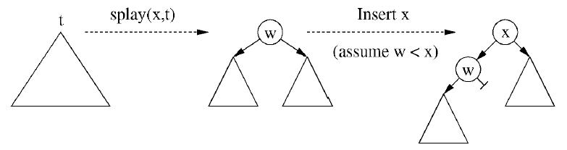
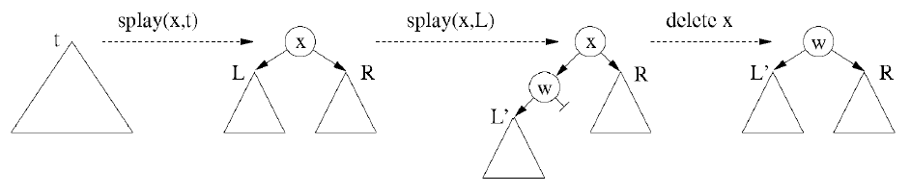
Summary of Splay Trees
Splay may be called before insertions as
Splay may be called before deletions as well, as

Slide 53
Compression via splay trees (example)
a
b
a
b
c
d
e
f
g
h
c
d
aabg...
e
f
g
h
000

Slide 54
Compression via splay trees (example)
a
b
a
b
c
d
e
f
g
h
c
d
aabg...
e
f
g
h
000
0

Slide 55
Compression via splay trees (example)
a
b
a
b
c
d
c
d
e
f
g
h
e
f
g
h
aabg...
0000
10

Slide 56
Compression via splay trees (example)
a
b
a
b
c
d
c
d
e
f
g
h
e
f
g
h
aabg...
0000
10
1110

Slide 57
Semi – splaying (Intro)
Regular zig - zig
z
*
x
==>
y
D
A
y
*
x
C
B
z
A
B
C
D
Semi-splay zig - zig
z
*
y
==>
y
D
x
z
*
C
x
A
B
C
D
A
B
Continue splay at y rather than at x.

Slide 58
Text Books
1. Data structures, Algorithms and Applications in C++, S.Sahni, University Press (India) Pvt Ltd, 2nd edition, Universities Press Orient Longman Pvt. Ltd.
2. Data structures and Algorithms in C++, Michael T.Goodrich, R.Tamassia and .Mount, Wiley student edition, John Wiley and Sons.
3. Data structures and Algorithm Analysis in C++, Mark Allen Weiss, Pearson Education. Ltd., Second edition.

Slide 59
References
1. Data structures and algorithms in C++, 3rd Edition, Adam Drozdek, Thomson 2. Data structures using C and C++, Langsam, Augenstein and Tanenbaum, PHI. 3. File Structures :An Object oriented approach with C++, 3rd ed, Michel J Folk, Greg Riccardi, Bill Zoellick

Slide 60
Links
https://www.slideshare.net/dharitachokshi/binary-search-tree-in-data-structure
https://www.powershow.com/view/11a76f-YjZhN/Priority_Search_Trees_powerpoint_ppt_presentation

Slide 61
Thank You

